Slide 1

Chaos Engineering: Love and Destruction
By Jessica Cherry
@AlyndertheRed1

Slide 2
Why do you love your K8s cluster?
You made this cool cluster right? You lovingly built this little cluster, added all your applications.
Spent hours to make sure everything works properly.
It is the great triumph of your work.
Or maybe you just love kubernetes… Who knows.

Slide 3

The at random breakdown (or On call incident)
Usually something goes horrifically wrong, which leads to an incident with a postmortem and temporary fix . Then we all forget about it.
But who do we call during that incident?

Slide 4

The Hero’s
The knowledge of working here forever means they save the day

Slide 5

After the Hero’s….
Once our top team of knowledge has fixed the issue we move on, with some temporary fix or patch we all forget about and move on in our lives.
Which I guess is fine, but we all know what that looks like…
In the end we will end up back on fire, with no documents and only 3 people will remember how it go fixed. (There’s no way I’ve been through this before)

Slide 6
So what do we change?
You need to constantly destroy the thing you love.
End the tribal knowledge, the on-call incidents and the hero’s who know everything about the cluster.
Make the documentation you need and stabilize your environment.

Slide 7

How do I start these changes?
Take notes during outages
Add post outage meetings
Monitor your systems
Get ready for science!

Slide 8
Chaos Engineering
What does Chaos Engineering require?
Define and measuring of your system
A hypothesis of what will happen
Plan, create and run the simulation
What is Chaos Engineering?
More science, planning and method than you would expect

Slide 9
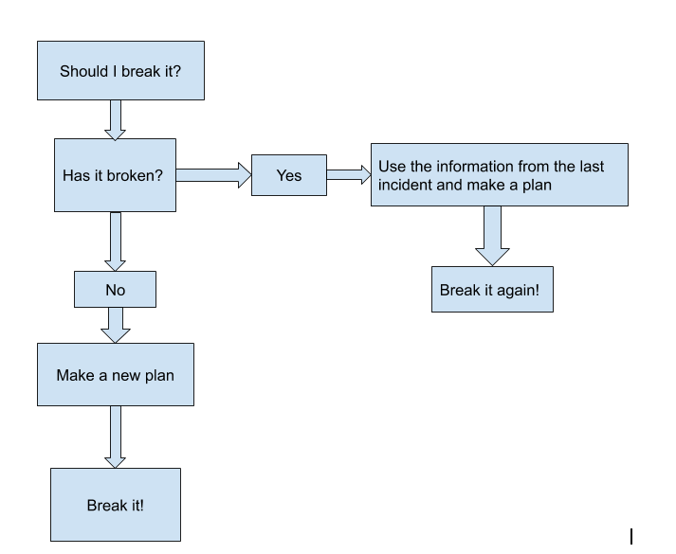
The Decision Graph
(How do you know if you need to destroy something?)
Quite Clearly we’re always going to destroy it

Slide 10

When to chaos engineer....
Now that you’ve seen my destruction decision chart and before we move on to tools, lets just quickly cover when the best time to chaos engineer is.
Now being the person I am and loving destruction in general, in my opinion anytime and all the time will be my answer.
However, if you do that no forward moving work will happen. So one suggestion I have is start at twice a year, work up to four times a year and then eventually to once a month if needed.

Slide 11

Tools required to start our new plan...
What tools do you need just to start?
Monitoring systems
  Prometheus
  Grafana
A list of historical issues from your environment
New Chaos engineering tools(Helm charts)
Yes I am this many years old

Slide 12
Wait what Chaos Engineering tools are you talking about?
(I’m so glad you asked)

Slide 13
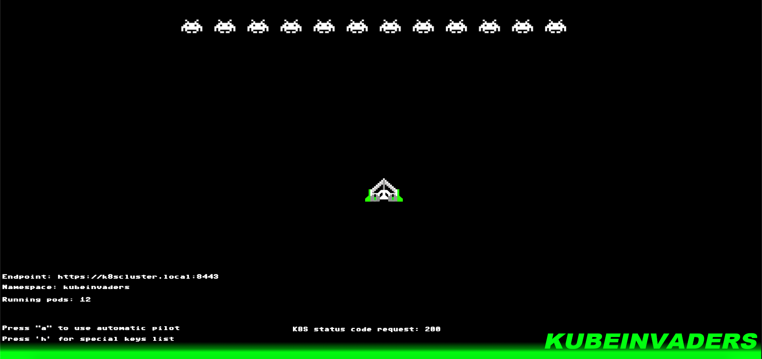
Lets play a game!
The first and fun Chaos engineering tool is KubeInvaders!
The space invaders gamified version of chaos engineering! You jump between namespaces and manually kill pods.
Proof that you can have fun and break things at the same time.
However it doesn’t work with EKS.

Slide 14
Chaos with a side of Web UI
The second tool on the list is Chaos mesh which is hosted by the CNCF.
It currently has a list of experiments you can choose from to test your cluster with a web front end to show you how the testing went. You can also define your own experiments in yaml. Once generated you just apply the experiment and let it run.
This tool does require some experience with yaml and helm.
Some example screenshots…..

Slide 15
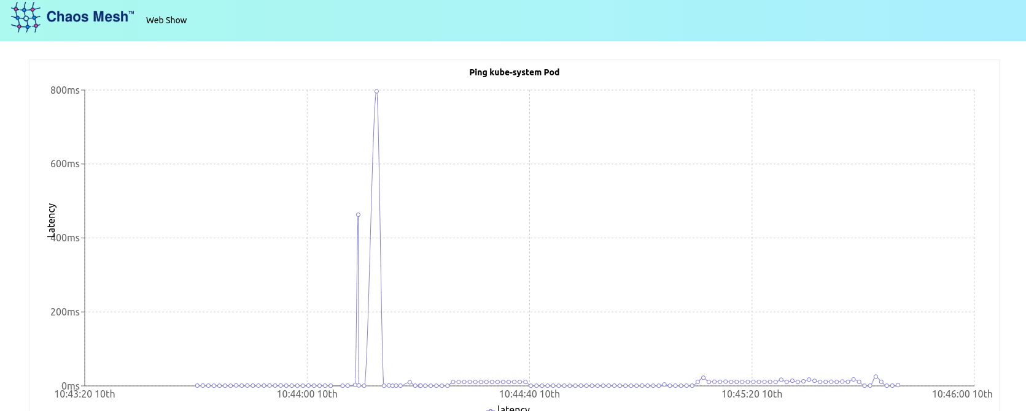
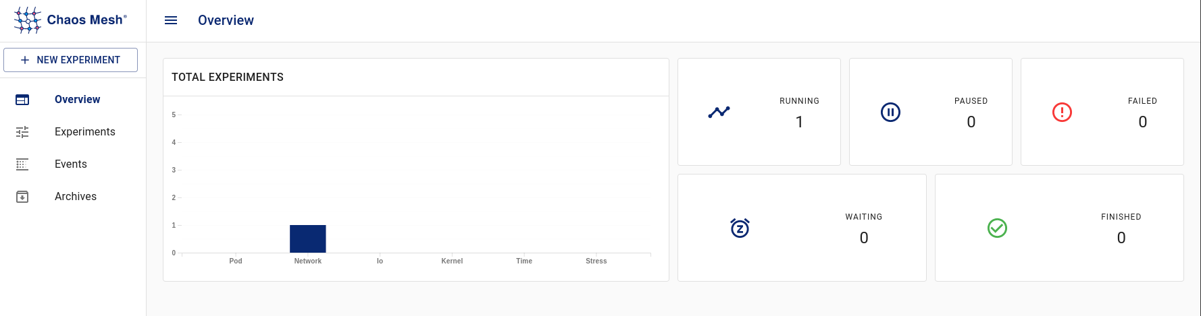

Slide 16
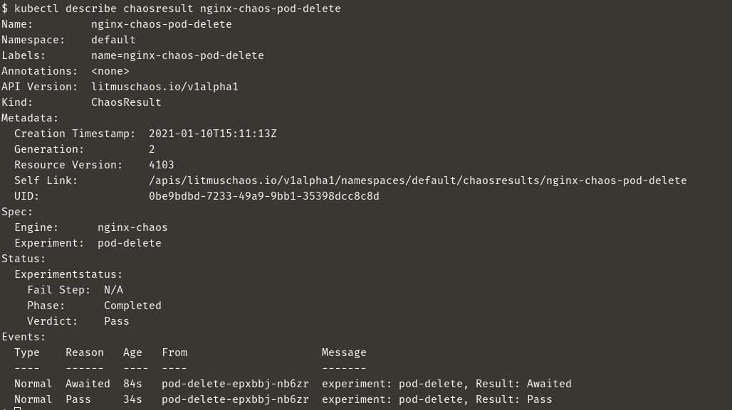
Seriousness...
The third tool on the list is Litmus.
This is more CLI heavy but has predefined tests for just about any issue you may run into. There’s a chaos hub you can get experiments from.
The community behind this tool is large and you can join in to add things as well.

Slide 17
Pod only Destruction
My last choice in chaos testing will be Chaoskube.
This tool kills pods by default in any namespace every ten minutes.
The main purpose is to test your systems under arbitrary failures over time. Sometimes just killing random pods over and over at random does give you a good system read and will show how the applications within will respond.
This tool can be limited by days and times including holidays, you can also limit with minimum age of the pod to test against. (TL;DR: Lots of filtering)
All it takes is a quick helm install and you’re good to go. (sorry no screenshots this time)

Slide 18

The more you know...
Now that you have a list of tools lets just roll through a quick recap on Chaos.
Monitor everything and keep numbers during stable times.
Come up with a plan of failure, or use one that has happened.
Test it with the new tools and hopefully you’re wrong about what’s going to happen, but if you just caused some destruction, write it down and plan for the future.
Documentation is key, write lots of it.
Profit????

Slide 19

Want to learn more?
Google “awesome chaos engineering” for a github link with books, tools and forums.

Slide 20
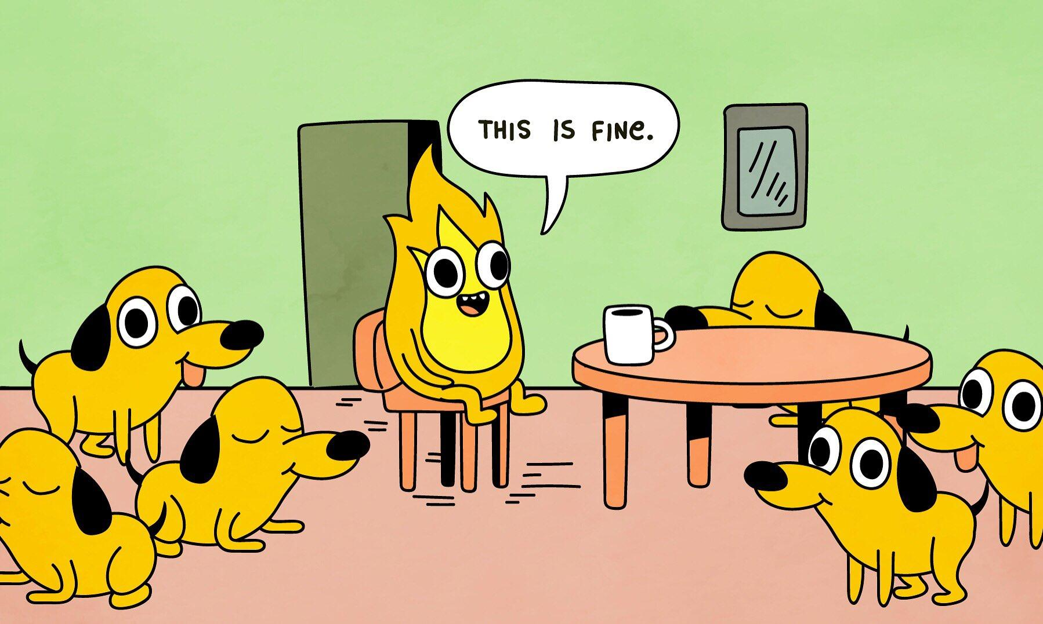
Chaos Engineering End Goal
How it started
How it’s going

Slide 21

Who am I?
Jessica Cherry
Follow, talk to me, or read my stuff?
Twitter:
@Alyderthered1 (Mostly run by my robots)
Linkedin: https://www.linkedin.com/in/cherrybomb/
My writings about stuff: https://opensource.com/users/cherrybomb
I’m just a crazy lady that likes to talk and write about Kubernetes things.
But mostly Destroying things...

